Slide 1

Health Facility Distributions in Neighbourhood of Toronto amid Corvid-19
Capstone Project - The Battle of Neighborhoods
by Jieun Kim

Slide 2
Introduction: Background
This project is completed as part of IBM’s Data Science Professional Certificate course offered by Coursera.org.
This project is about analysing health facilities' distribution in Toronto area. Toronto has been heavily hit by Corvid-19 among any other large cities in Canada. There are currently 2,881 confirmed and probable cases of the virus in Toronto, including 147 death as of 17 April.
Toronto is the largest city, however, recorded relatively lower density of population compared to Vancouver for instance. Many scientists are wondering why Toronto becomes most victim in this pandemic.
The project looks for the number of hospital facilities and their distributions in the neighbourhood. This attempts will help diagnose the current overcrowding situation and support health-related decision makers concerning how to improve health system in Toronto, in particular.

Slide 3
Introduction: Problem
The object of this project is to analyse neighbourhood of Toronto, where health facilities has snot sufficiently reached, or overly populated. With the help of Data Science Methodology and machine learning techniques, we can certainly build an analysis to raise issues about following question
Are health facilities in Toronto equally distributed through the neighborhood

Slide 4
Methodology (1) Data Source
Wikipedia Canada Ontario-Toronto postcode data
https://en.wikipedia.org/wiki/List_of_postal_codes_of_Canada:_M
2) Foursquare : Search query (Hospital, Pharmacy)
3) Statistics of Corvid-19 Canada
Notes:
Methodology section which represents the main component of the report where you discuss and describe any exploratory data analysis that you did, any inferential statistical testing that you performed, if any, and what machine learnings were used and why.

Slide 5
Methodology (2) Data Analysis
The analytic approach for this problem is to perform unsupervised learning technique such as K-means Clustering. This will help to identify various patterns based on neighbourhoods in Tronto.
•We would require data such as list of Boroughs and Neighbourhood of Toronto, also the Corvid data for Toronto area)
•Once we have noted the data requirements, the next step is data collection. We need to scrape data from the online websites using libraries such as Beautiful Soup. Also, using Foursquare.
Notes:
Methodology section which represents the main component of the report where you discuss and describe any exploratory data analysis that you did, any inferential statistical testing that you performed, if any, and what machine learnings were used and why.

Slide 6
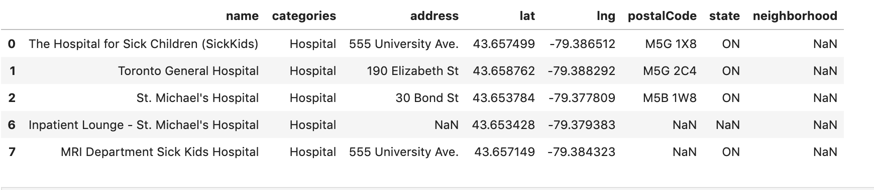
Data gathering : Hosptial (n=14)

Slide 7
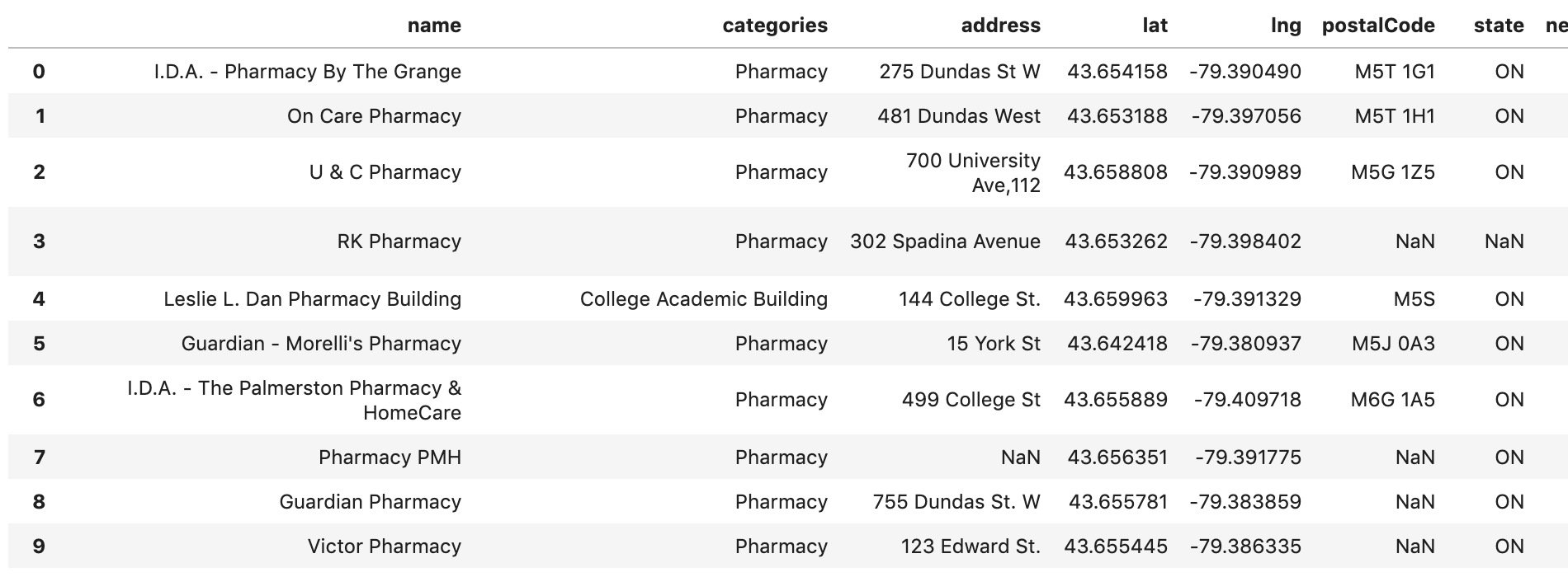
Data gathering : Phamarcy (n=50)

Slide 8
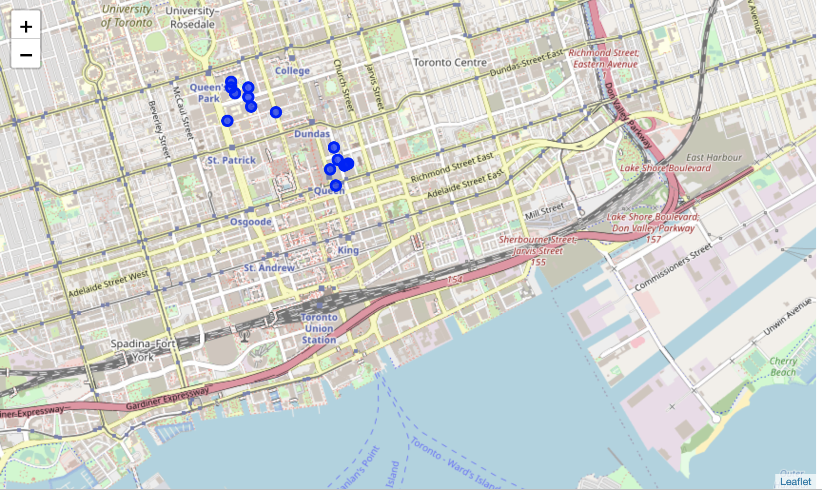
Distribution of Health facility marked
Health Facilities including hoptial, emergency unity, and pharmacy, are not populated in Foursquare site.
More facilities are marked toward university zone.

Slide 9
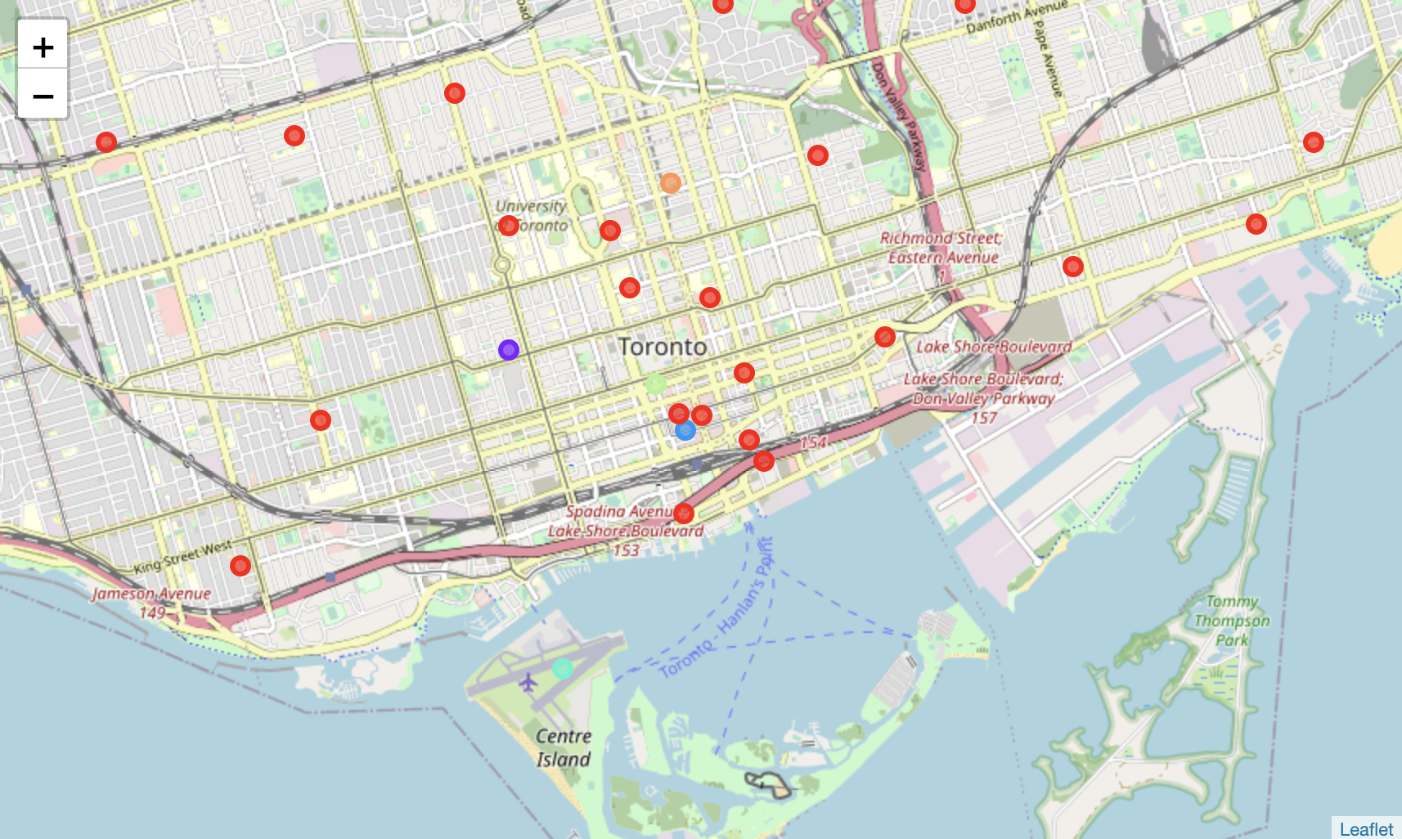
Characterising Neighborhood : K-mean cluster analaysis (K=6)
- Neighboorhood in main area of Toronto is likely to show similar popular venue (Cluster 1 in red)
-Populated with many restaurants and also gym& yoga studio

Slide 10
Discussion
As per analysis done in this project, it is recommended to disperse hospital facility in neighbourhood of Toronto
Cluster 1 includes cities such as CN Tower / King and Spading and University area , they are the one’s with high density of hospital facility .
However, this results might be biased as long as the current capstone rely on Foursquare data only for venue makered which is highly popular for “attractions” and “restaurants”,
Notes:
Discussion section where you discuss any observations you noted and any recommendations you can make based on the results.

Slide 11
Conclusion
With the help of Foursquare API and various machine learning techniques we can perform analysis on various other venues and can answer many business problem.
Basis on the Data visualization we can have a good understanding why a particular neighbourhood is overwhelmed with hospitals, and others are not.
Notes:
Conclusion section where you conclude the report.

Slide 12
Health Facility Distributions in Neiborhood of Toronto amid Corvid-19
Capstone Project - The Battle of Neighborhoods
by Jieun Kim

